Slide 1
Gyro on smartphones
Perfomed by Gasayni Rabadanov

Slide 2
content
Advantages
Comparing gyro and accelerometers
Uses in games
Why we can’t do without a gyro
MEMS
Gyro in iPhone the 4th
Conclusion

Slide 3
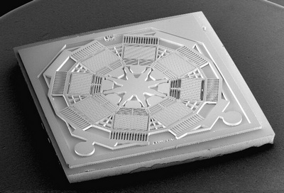
Every mobile phone has a gyro inside

Slide 4
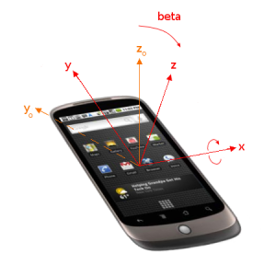
Gyros and accelerometers are usually used for orientation in smartphones

Slide 5
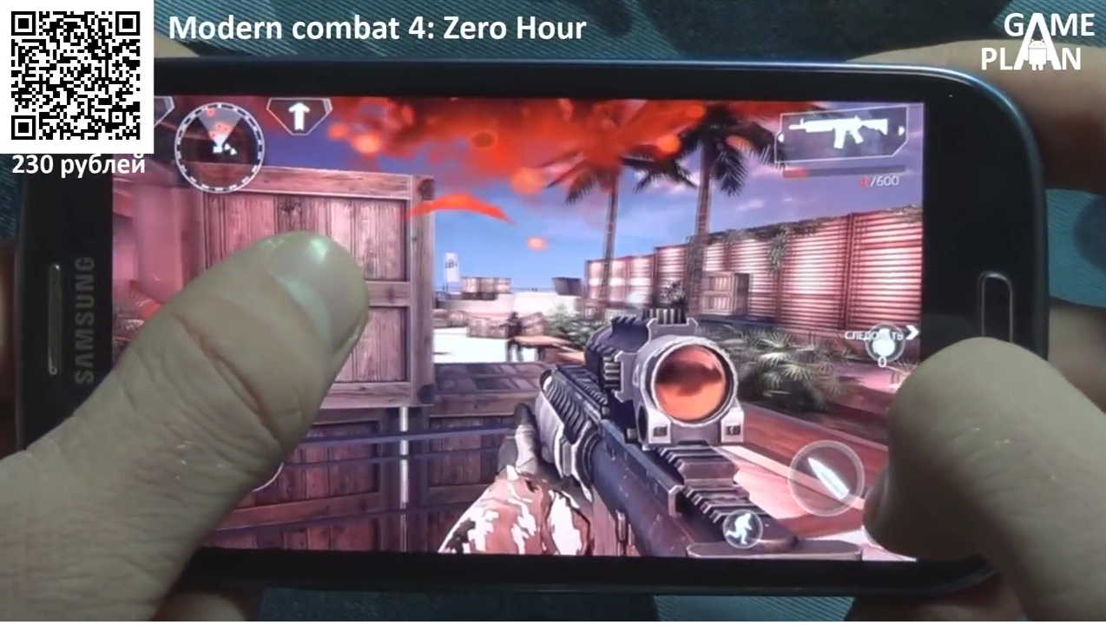
There are a lot of practical uses of gyroscope especially in mobile games

Slide 6
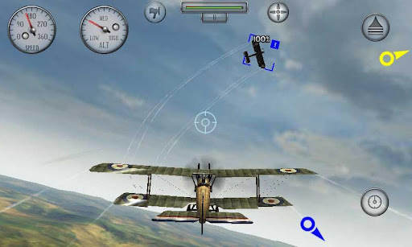
We have many ways of using gyroscopic device in games

Slide 7
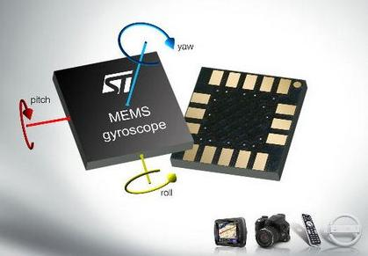
MEMS are usual system for our mobile devices

Slide 8
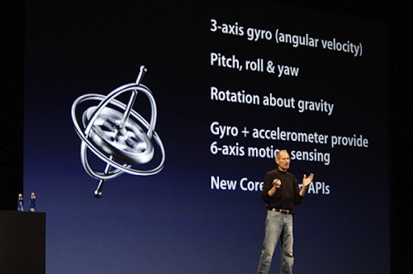
Apple was the first company to introduce using gyros in smartphones

Slide 9
Conclusion
Gyroscope changed the way people interact with their mobile phones. And it was a real treasure for gamers.

Slide 10
References
http://mobilegyros.blogspot.ru/
https://ru.wikipedia.org/wiki/%D0%93%D0%B8%D1%80%D0%BE%D1%81%D0%BA%D0%BE%D0%BF

Slide 11
Thank you for your attention. Any questions are welcome.

