Slide 1

Accelerometer vs. Gyroscope
by Khalimova Evgenia

Slide 2
Сontents
What is a gyroscope?
What is an accelerometer?
Uses of a gyroscope or accelerometer
What is the difference between Gyro and Accelerometer?

Slide 3
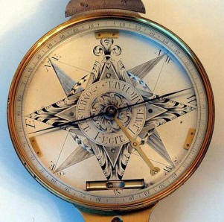
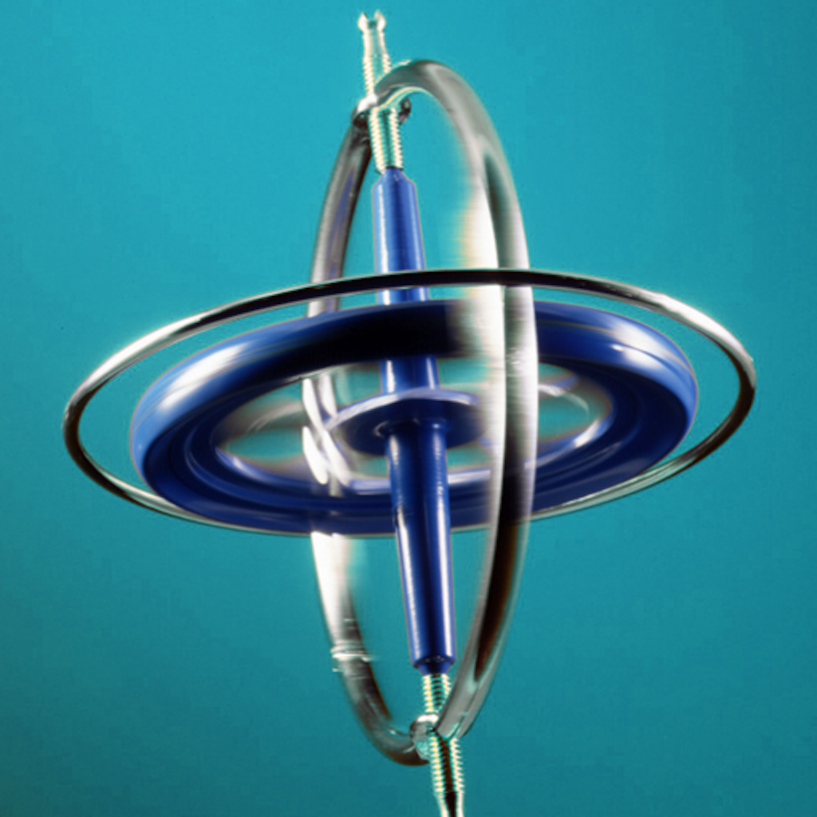

What is a gyroscope?
Back

Slide 4

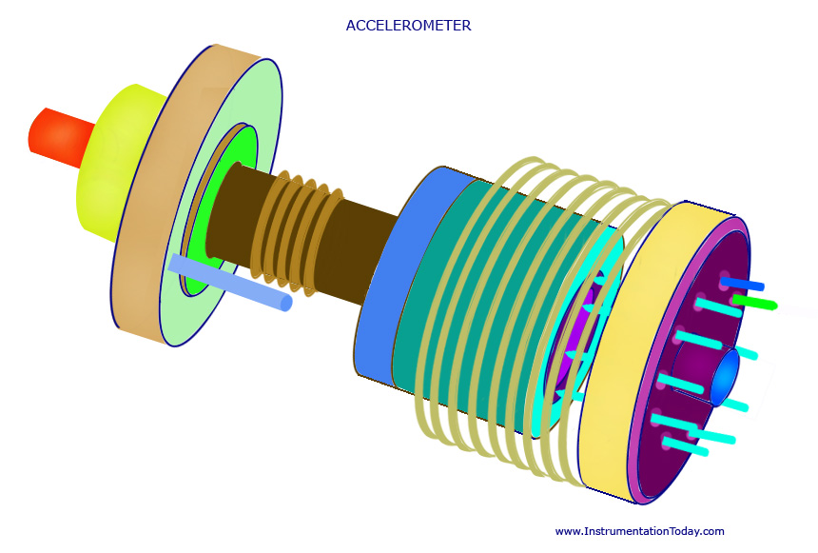
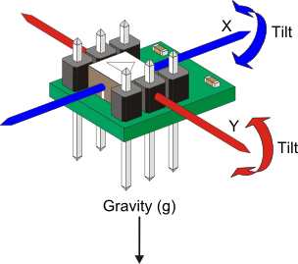

What is an accelerometer?
Back

Slide 5





Uses of a gyroscope or accelerometer
Back

Slide 6
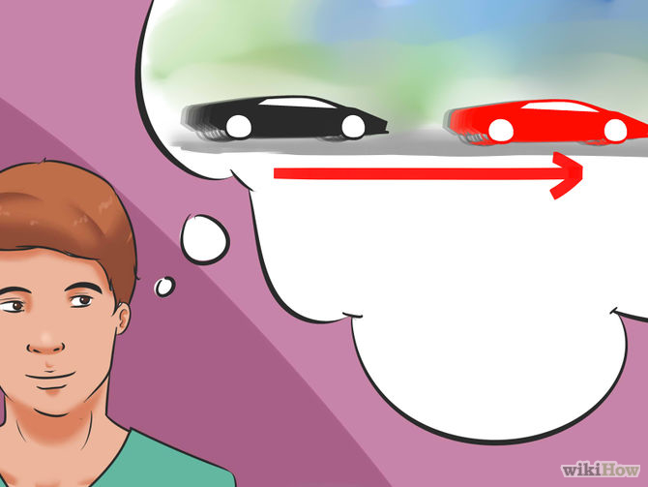
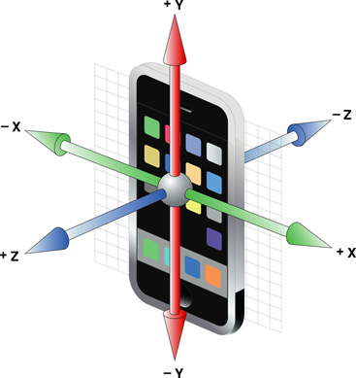
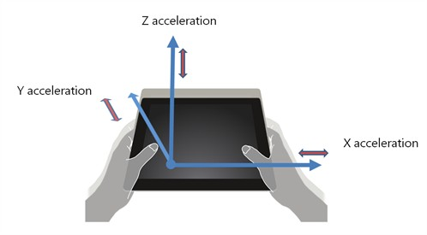

What is the difference between Gyro and Accelerometer?
Thanks for your attention.
Back

