Slide 1
Gyrocompass
performed by
Itunin Alexandr
ICS2-62
Language adviser
Belova E.A.

Slide 2
Content
Definition
The difference between gyroscope and gyrocompass
Construction
Application features
Heading indicators
Errors
Conclusion

Slide 3
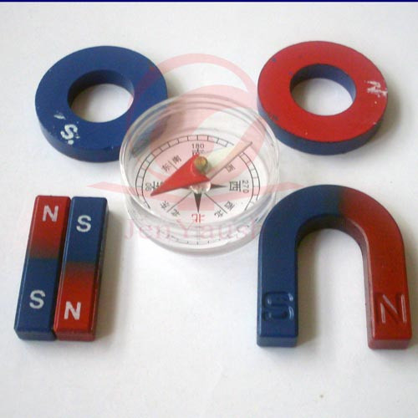
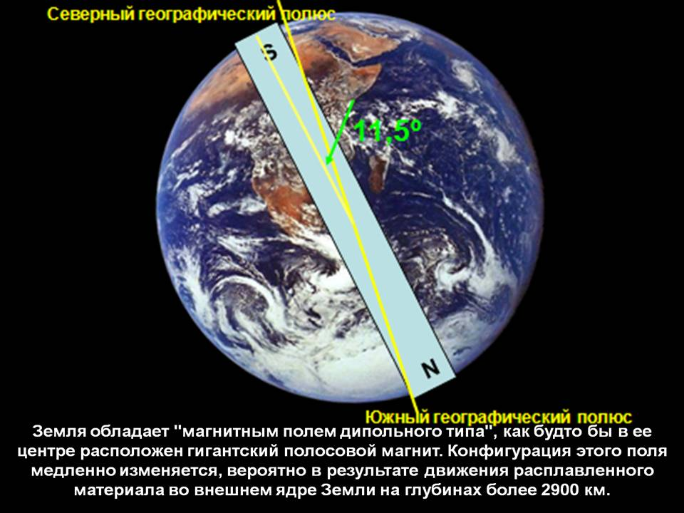
A gyrocompass is a type of non-magnetic compass which is based on a fast-spinning disc and rotation of the Earth

Slide 4
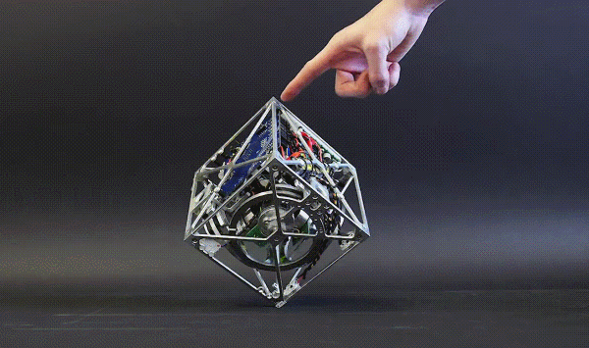
Gyroscope normally maintains its original orientation to a fixed point in outer space

Slide 5
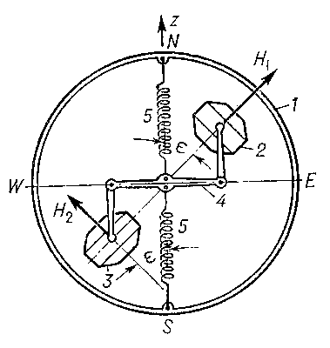
The crucial additional ingredient needed to turn a gyroscope into a gyrocompass

Slide 6
It will not orient itself correctly to true north if it is moved very fast in an east to west direction, thus negating the Earth's rotation.

Slide 7
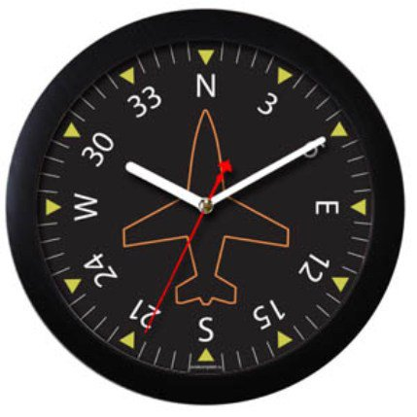
Aircraft commonly uses heading indicators or directional gyros

Slide 8
A gyrocompass is subject to certain errors

Slide 9
Gyrocompasses are used on slow vehicles

Slide 10
Сonclusions
It became much easier to navigate since the invention of gyrocompasses.

Slide 11
References
http://www.sudno1.ru/giro.shtml
http://www.krugosvet.ru/enc/nauka_i_tehnika/tehnologiya_i_promyshlennost/GIROKOMPAS.html
https://ru.wikipedia.org/wiki/%D0%93%D0%B8%D1%80%D0%BE%D0%BA%D0%BE%D0%BC%D0%BF%D0%B0%D1%81

Slide 12
Thank you for your attention. Any questions are welcome.

