Slide 1
Powerball (Gyroscope ball)
Performed by
Karmatskiy Nikita
IU2-62
Moscow 2016

Slide 2
Content
1 | What is powerball?
2 | Construction
3 | How it works?
4 | Exercises with powerball
5 | Conclusion

Slide 3
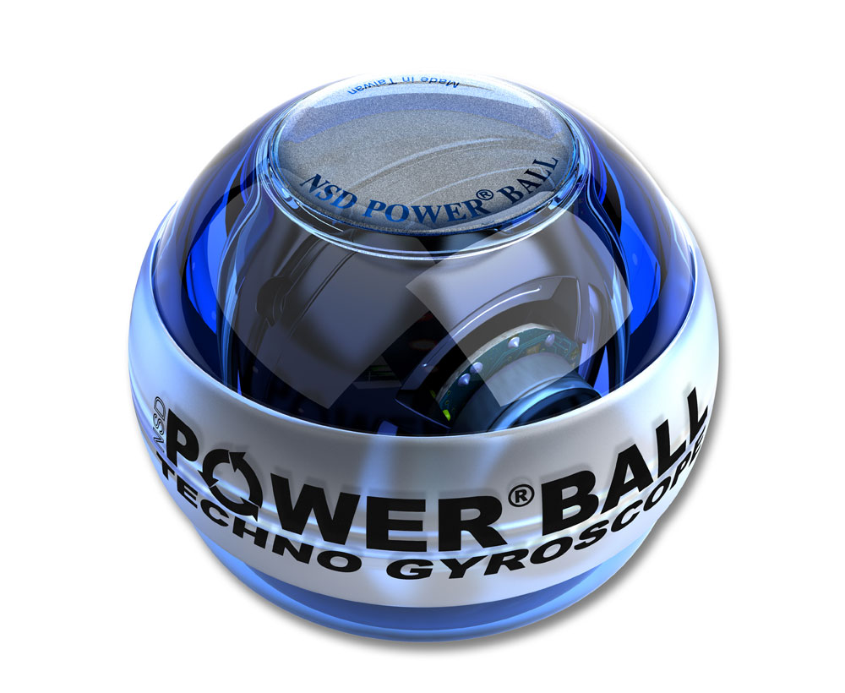
What is powerball?
Powerball is a compact sports simulator which principle of operation is based on the properties of the gyro rotor.

Slide 4
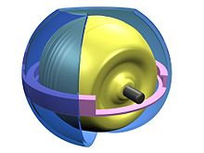
Construction of a powerball
The case
Rotor
Restrictive ring

Slide 5
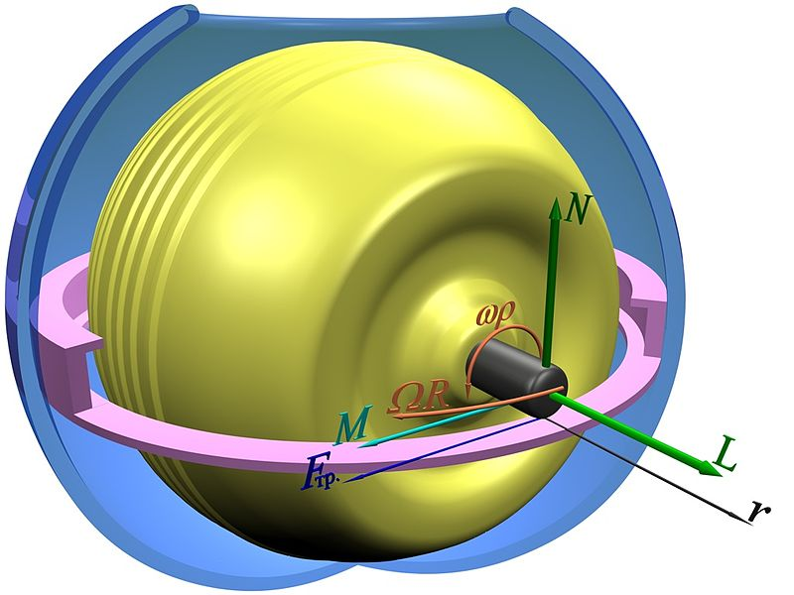
How the powerball works?
The Power Ball Gyroscope demonstrates the significance of torque. The greater the angular velocity of the rotor, the greater the force needed to change the orientation of the gyro ball.

Slide 6
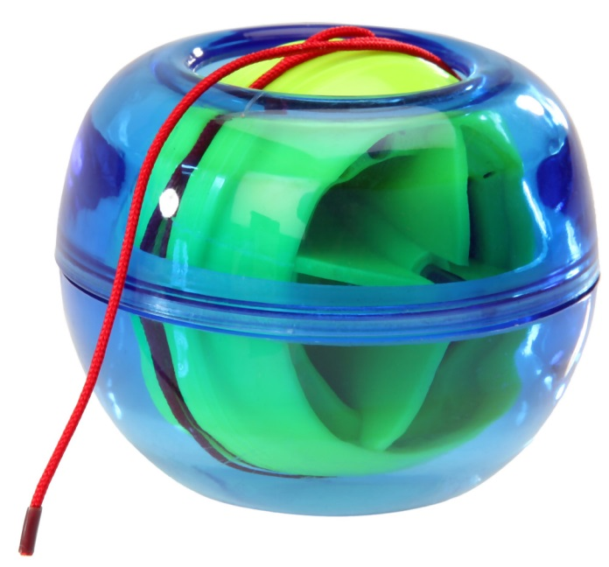
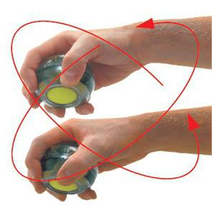
No physics please! Try to explain it in a more simple way!
Pull a sting and try to spin!

Slide 7
What is this powerball used for?
Humans are designed to move and skeletal muscle needs to be used to avoid atrophy and loss of strength.

Slide 8
Conclusion
Powerball is a great invention that helps you not only to spend your time spinning it, but also for injury prevention and to discover some gyroscopic properties.

Slide 9
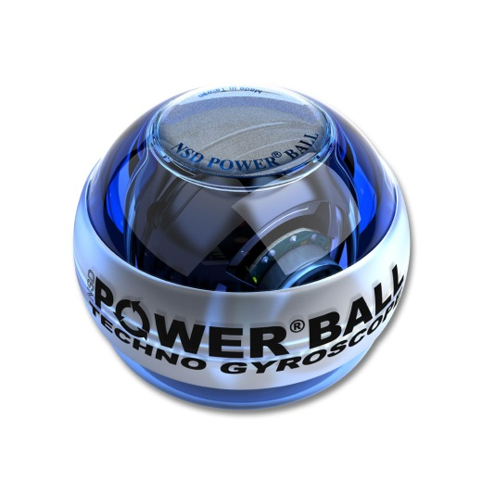
Thank you for your attention. Any questions are welcome but not desirable. ☺

Slide 10
References
https://ru.wikipedia.org/wiki/Гироскопический_тренажёр
http://powerballs.com/how-it-works/
http://www.arborsci.com/power-ball-gyroscope

Slide 11
Special thanks to https://translate.google.ru/ ☺

