Slide 1
Rate gyro
Prividenko V. IU2-69

Slide 2
Content
1.Introduction
2.Principle of operation
3.Calculating the angle
4.Floated gyro unit
5.References

Slide 3
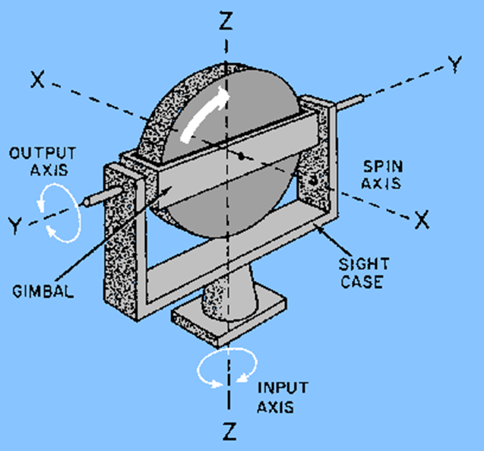
Figure 1. - Rate gyro (single degree of freedom).

Slide 4
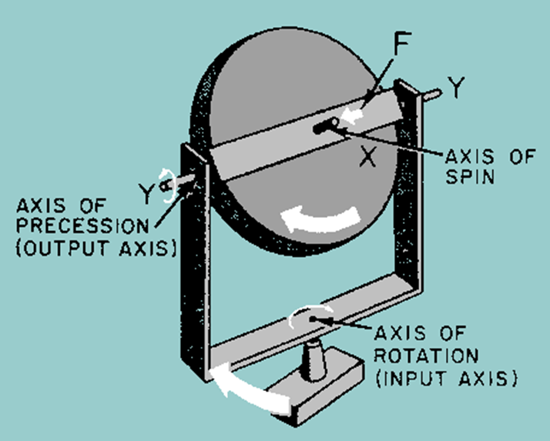
Figure 2. - Rate gyro precession.

Slide 6
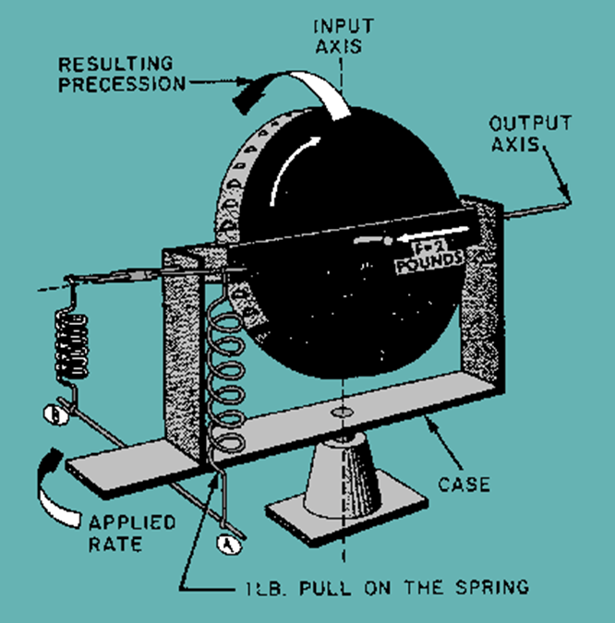
Figure 3- Precession of a spring restrained rate gyro.

Slide 7
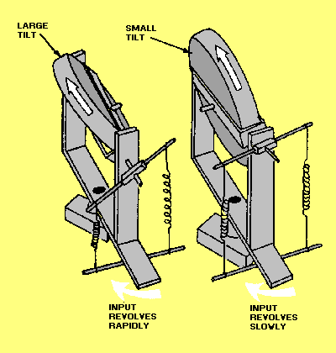
Figure 4- Precession is proportional to the rate of rotation.

Slide 8
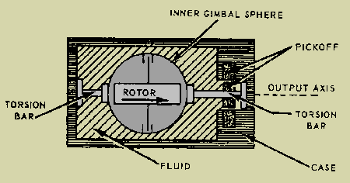
Figure 5- Torsion bar-restrained floated rate gyro.

Slide 9
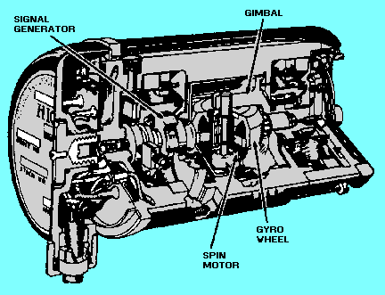
Figure 6. - Rate gyro, cutaway view.

Slide 10
References
1. Integrated Publishing http://www.tpub.com/neets/book15/63e.htm

