Slide 1
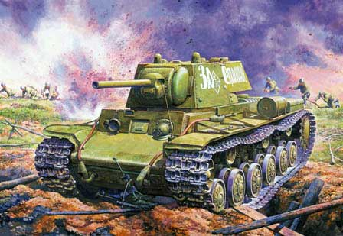
Stabilizer cannon tanks
performed by
Proskuryakov Aleksey
ICS2-52

Slide 2
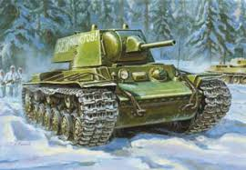
Contents
1. Definition 2. The structure of the stabilizer 3. The reason for using a stabilizer 4. The inventor of this device 5. The relevance of the use of the stabilizer

Slide 3
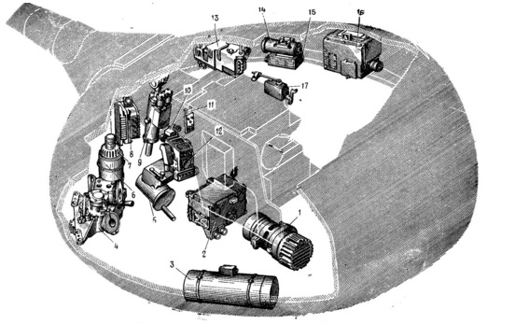
The main parts of stabilizer

Slide 4
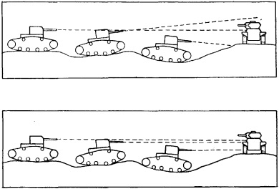
Tank guns need the gyro stabilizers

Slide 5
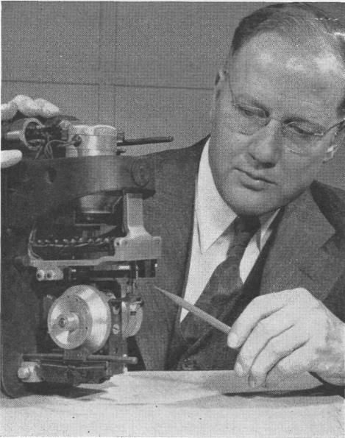
The inventor
Clinton Richards Hanna ( 17.12.1899 – 23.05.1976 )

Slide 6
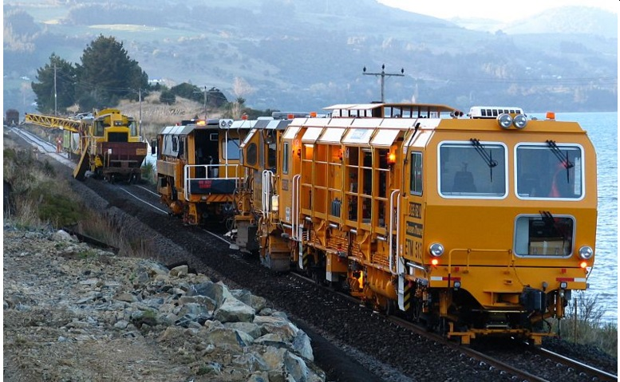
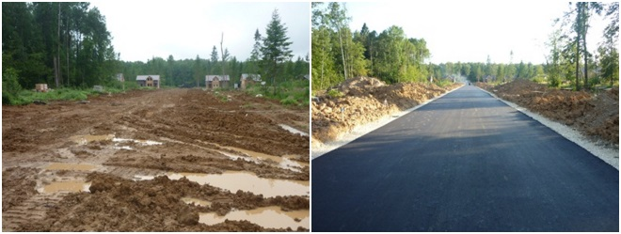
Other uses of the stabilizer

Slide 7
Thank you for your attention

