Slide 1
Image stabilization
Perfomed by
Sokolov Mihail
ICS2-52

Slide 2
Content
Description
Application in still photography
Optical image stabilization
Digital image stabilization
Stabilization filters
Stabilizing the camera body
Camera stabilizer
In biological eyes
Conclusion

Slide 3
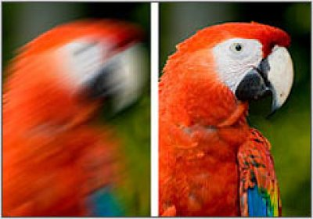
Description

Slide 4
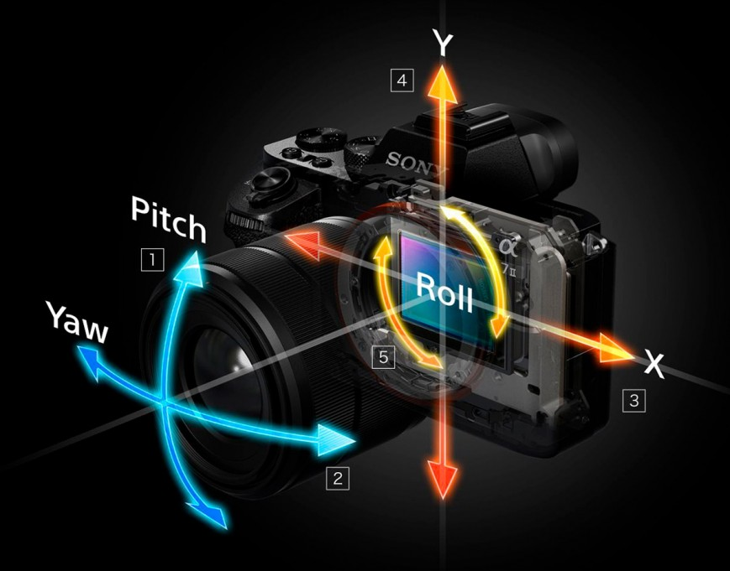
Application in still photography

Slide 5
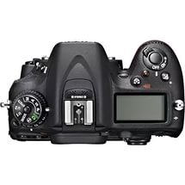
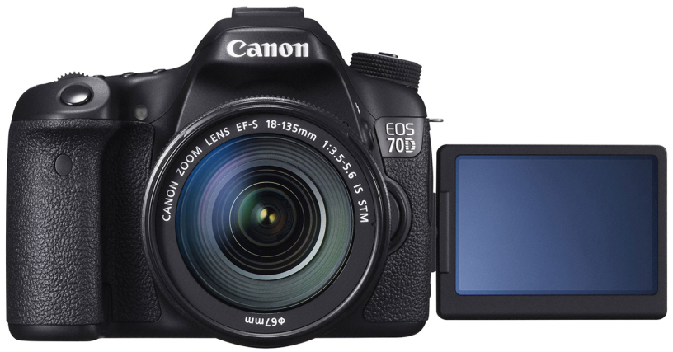
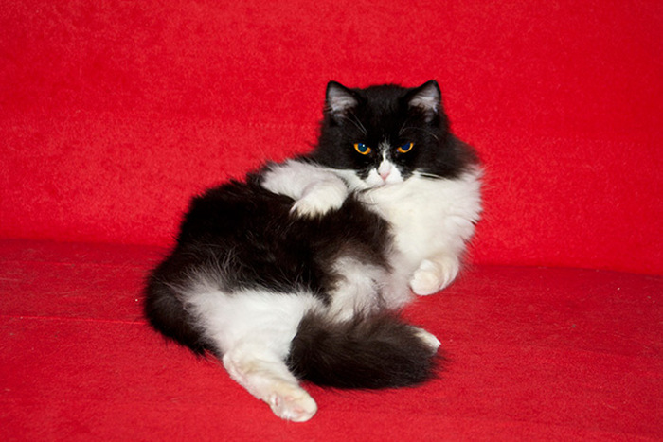
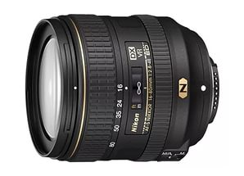
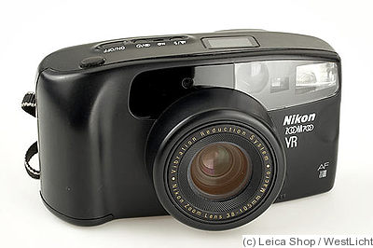
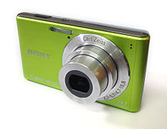
Optical image stabilization
Image Stabilizer (IS) - Canon
Vibration Reduction (VR) - Nikon
Optical SteadyShot (OSS) - Sony

Slide 6
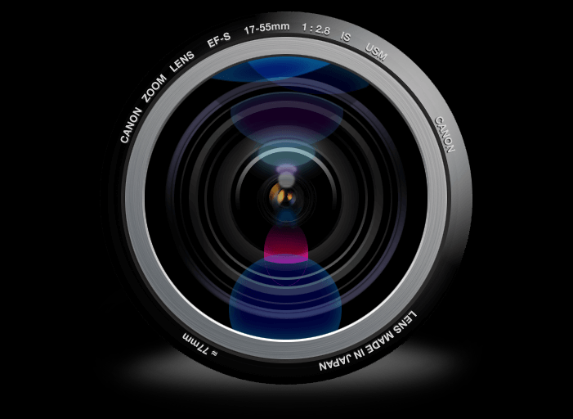
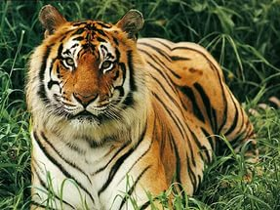
Digital image stabilization
Image
pixels
Spare
pixels

Slide 7
Stabilization
filters

Slide 8
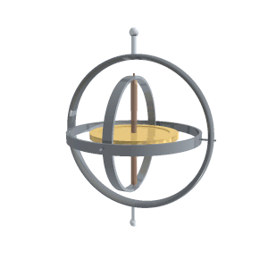
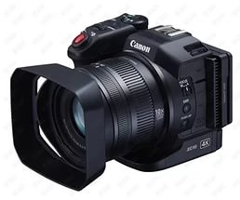
Stabilizing the camera body

Slide 9
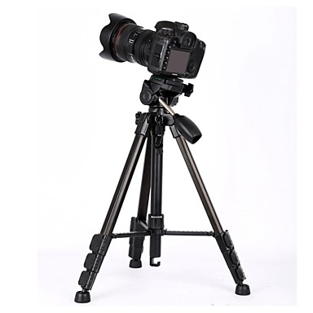
Camera stabilizer

Slide 10
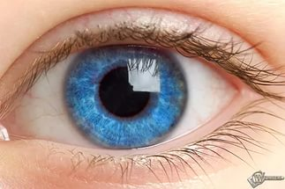
In biological eyes

Slide 11
Thanks for attention!

